Slide 1





Slide 2



Slide 3

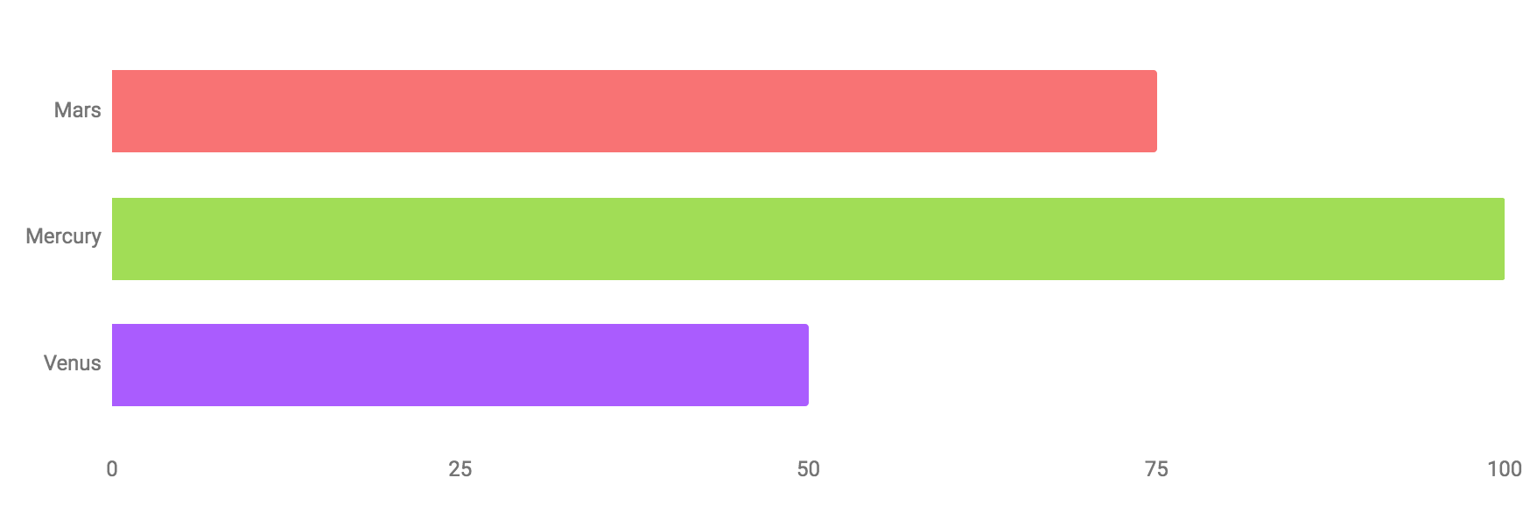
19K
35K
15K
Reacts
Reviews
FeedBacks

Slide 4
How Can I Classify These Feedbacks!
19K
35K
15K
Reacts
Reviews
FeedBacks

Slide 5
How Can I Classify These Feedbacks!
19K
35K
15K
Reacts
Reviews
FeedBacks

Slide 6


How Can I Classify These Feedbacks!
Arabic Sentiment Analyzer (ASA)

Slide 7
Arabic Sentiment Analyzer (ASA)
Project Understanding
Feature Engineering
Identify the Problem and how to solve it
Feature Extraction and Engineering
Gathering Data
Modeling
Data requirements and Collecting
Model building and Evaluating
Data Preprocessing
Deployment
Data wrangling and Preprocessing
Deploying model and collecting Feedbacks
Project Methodology

Slide 8


Arabic Sentiment Analyzer (ASA)
Project Understanding
Feature Engineering
Identify the Problem and how to solve it
Feature Extraction and Engineering
Goal
Tools
Gathering Data
Modeling
Project Methodology
Data requirements and Collecting
Model building and Evaluating
Data Preprocessing
Deployment
Data wrangling and Preprocessing
Deploying model and collecting Feedbacks
Create a tool that can accurately gauge the sentiment expressed in Arabic text, with potential applications in social media monitoring, customer feedback analysis, and more.
This project to develop an application using Python Programming Language in Jupyter Notebook as an environment.

Slide 9
Arabic Sentiment Analyzer (ASA)
أنا أحب مصر
Project Understanding
Feature Engineering
Feature Extraction and Engineering
85 %
Goal
Tools
Gathering Data
Modeling
Data requirements and Collecting
Model building and Evaluating
Create a tool that can accurately gauge the sentiment expressed in Arabic text, with potential applications in social media monitoring, customer feedback analysis, and more.
This project to develop an application using Python Programming Language in Jupyter Notebook as an environment.
Data Preprocessing
Deployment
Data wrangling and Preprocessing
Deploying model and collecting Feedbacks
15 %

Slide 10
Example
Arabic Sentiment Analyzer (ASA)
Project Understanding
Feature Engineering
إيجابي
Identify the Problem and how to solve it
85 %
Feature Extraction and Engineering
Goal
To provide valuable:
Insights
Emotions
Attitudes
أنا أحب مصر
Gathering Data
Modeling
Data requirements and Collecting
Model building and Evaluating
Create a tool that can accurately gauge the sentiment expressed in Arabic text, with potential applications in social media monitoring, customer feedback analysis, and more.
This project to develop an application using Python Programming Language in Jupyter Notebook as an environment.
Data Preprocessing
سلبي
Deployment
15 %
Data wrangling and Preprocessing
Deploying model and collecting Feedbacks
Project Methodology

Slide 11
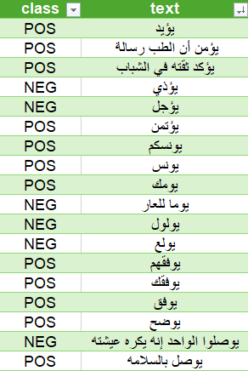

Arabic Sentiment Analyzer (ASA)
إيجابي
85 %
Project Understanding
Feature Engineering
Identify the Problem and how to solve it
Feature Extraction and Engineering
To provide valuable:
Insights
Emotions
Attitudes
Gathering Data
Modeling
Project Methodology
Data requirements and Collecting
Model building and Evaluating
Data Preprocessing
Deployment
Data wrangling and Preprocessing
Deploying model and collecting Feedbacks
Large Dataset
The project utilized a curated Arabic dataset with over 12.5K observations, ensuring the model had a robust and diverse set of training examples.
أنا أحب مصر
سلبي
15 %

Slide 12

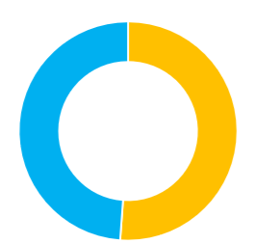
Arabic Sentiment Analyzer (ASA)
Gathering Data
Project Understanding
Feature Engineering
Identify the Problem and how to solve it
Feature Extraction and Engineering
Large Dataset
The project utilized a curated Arabic dataset with over 12.5K observations, ensuring the model had a robust and diverse set of training examples.
Modeling
Model building and Evaluating
Data Preprocessing
Deployment
Data wrangling and Preprocessing
Deploying model and collecting Feedbacks
diverse labels
The dataset's sentiment labels were meticulously curated and Diverse providing the model with accurate and reliable ground truth for the training process.
12.5K
Project Methodology
51 %
Negative Labels
6.62K Observations
49 %
Positive Labels
6.32K Observations

Slide 13
Arabic Sentiment Analyzer (ASA)
Gathering Data
Project Understanding
Feature Engineering
Identify the Problem and how to solve it
Feature Extraction and Engineering
12.5K
Large Dataset
diverse labels
The project utilized a curated Arabic dataset with over 12.5K observations, ensuring the model had a robust and diverse set of training examples.
The dataset's sentiment labels were meticulously curated and Diverse providing the model with accurate and reliable ground truth for the training process.
Modeling
Data requirements and Collecting
Model building and Evaluating
51 %
Negative Labels
Data Preprocessing
6.62K Observations
Deployment
Data wrangling and Preprocessing
49 %
Deploying model and collecting Feedbacks
Positive Labels
6.32K Observations
Project Methodology

Slide 14
Arabic Sentiment Analyzer (ASA)
Project Understanding
Feature Engineering
Identify the Problem and how to solve it
Feature Extraction and Engineering
Gathering Data
Modeling
Project Methodology
Data requirements and Collecting
Model building and Evaluating
Data Preprocessing
Deployment
Data wrangling and Preprocessing
Deploying model and collecting Feedbacks
12.5K
diverse labels
The dataset's sentiment labels were meticulously curated and Diverse providing the model with accurate and reliable ground truth for the training process.
51 %
Negative Labels
6.62K Observations
49 %
Positive Labels
6.32K Observations

Slide 15
Arabic Sentiment Analyzer (ASA)
Tokenization Function
01
02
Part Of Speech Handling
Converting sentence to words
Categorize words into their respective classes.
Data Preprocessing
NER Handling
03
04
Normalization Function
Extracts information from text, categorizing entities
Converting unstructured text into a more uniform format
Remove Stop Words
05
06
Stemming Function
Removing non-effective words
Reduces inflectional forms of words to their root
Project Methodology

Slide 16
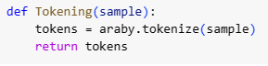



Tokenization Function
PyArabic
Library
This project used tokenize function from araby module in PyArabic library
Tokening
Function
أنا أحب مصر
Tokening function works on dividing the sentence into words
مصر
أحب
أنا
NLTK
Library
This project used StanfordPOSTagger model from tag module.
PartOfSpeech
Function
POS function works on extracting words tags and filters the unwanted tags like “انا”, “سيارة”, “بيت”, “و”

Slide 17
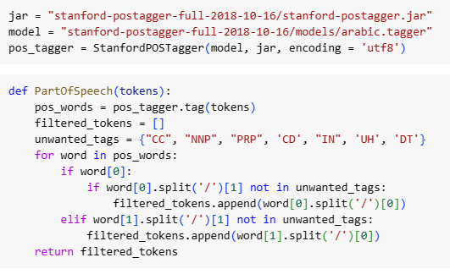
Part Of Speech Handling
PyArabic
NLTK
Library
Library
We used tokenize function from araby module in PyArabic library
This project used StanfordPOSTagger model from tag module.
Tokening
PartOfSpeech
Function
Function
Tokening function works on dividing the sentence into words
POS function works on extracting words tags and filters the unwanted tags like “انا”, “سيارة”, “بيت”, “و”
أنا أحب مصر
مصر
أحب
أنا

Slide 18

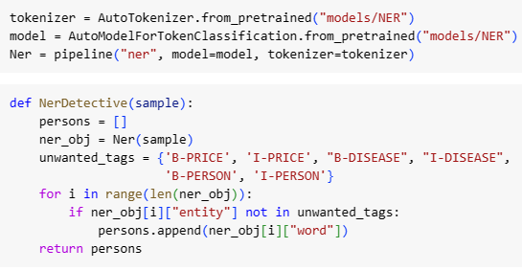

Named Entity Recognition
NLTK
transformers
Library
Library
This project used StanfordPOSTagger model from tag module.
This project used hatmimoha model for Arabic NER published on Hugging Face Website.
NER
Function
NER function works on extracting words with specific tags and filters it like “سعيد”, “جائزة”, “كورونا”
PartOfSpeech
Function
POS function works on extracting words tags and filters the unwanted tags like “انا”, “سيارة”, “بيت”, “و”

Slide 19

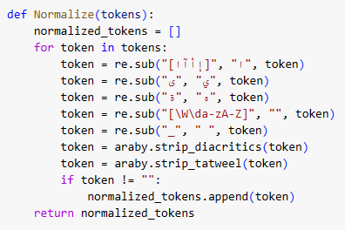

Normalization
transformers
re
Library
Library
This project used hatmimoha model for Arabic NER published on Hugging Face Website.
This project used Substitute function in Regular Expression library for Normalization
NER
Normalize
Function
Function
NER function works on extracting words with specific tags and filters it like “سعيد”, “جائزة”, “كورونا”
The normalize function is designed to check if a specific string matches given letters and to standardize all words by eliminating Tatweel, diacritics, and English letters.

Slide 20

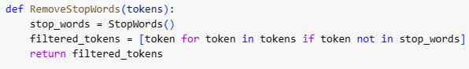
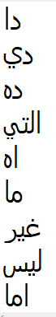
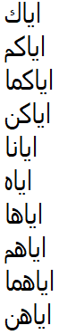
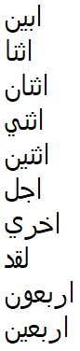
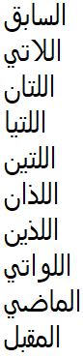
Stop Words Handling
RemoveStopWords
re
Function
Library
This function is designed to check for each word in the sentence if it’s a stop word to remove it
This project used Substitute function in Regular Expression library for Normalization
Stop Words Dataset
533
Created a dataset with over 500 words that is not usfull in sentiment analysis
Normalize
Function
The normalize function is designed to check if a specific string matches given letters and to standardize all words by eliminating Tatweel, diacritics, and English letters.

Slide 21
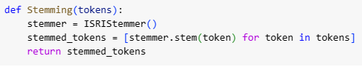
Stemming
RemoveStopWords
ISRIStemmer
01
02
Function
Module
This function is designed to check for each word in the sentence if it’s a stop word to remove it
This project used Stem function from ISRIStemmer module located in NLTK library.
03
04
Stop Words Dataset
Stemming
533
Created a dataset with over 500 words that is not usfull in sentiment analysis
Function
05
Stemming helps improve the accuracy of sentiment classification by simplifying word variations while preserving the essential meaning of the text.
Data Preprocessing

Slide 22
ISRIStemmer
Module
This project used Stem function from ISRIStemmer module located in NLTK library.
Tokenization Function
01
02
Part Of Speech Handling
Converting sentence to words
Categorize words into their respective classes.
Data Preprocessing
NER Handling
03
04
Normalization Function
Extracts information from text, categorizing entities
Converting unstructured text into a more uniform format
Remove Stop Words
05
06
Stemming Function
Removing non-effective words
Reduces inflectional forms of words to their root
Stemming
Function
Stemming helps improve the accuracy of sentiment classification by simplifying word variations while preserving the essential meaning of the text.

Slide 23
Arabic Sentiment Analyzer (ASA)
Project Understanding
Feature Engineering
Identify the Problem and how to solve it
Feature Extraction and Engineering
Gathering Data
01
Modeling
02
Project Methodology
Data requirements and Collecting
Model building and Evaluating
Data Preprocessing
Deployment
Data wrangling and Preprocessing
Deploying model and collecting Feedbacks

Slide 24
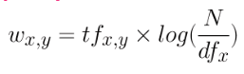
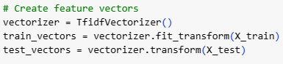

Arabic Sentiment Analyzer (ASA)
Feature Engineering
Term Frequency
Num. of Documents
Project Understanding
Identify the Problem and how to solve it
Document Frequency
Gathering Data
01
02
03
04
Data requirements and Collecting
TF-IDF
Feature Extraction
SciKit-Learn Library
Improved Performance
The TF-IDF (Term Frequency-Inverse Document Frequency) is a measure of originality of a word by comparing the number of times a word appears in a doc with the number of docs the word appears in
By identifying the most significant features in the Arabic text, the TF-IDF Vectorizer was used to transform the text data into a numerical matrix that could be fed into the machine learning model to help it better understand the sentiment expressed in the data.
The project used the TfidfVectorizer function from feature_extraction.text module located in sklearn library
The TF-IDF Vectorizer's ability to capture the significance of words and phrases within the Arabic dataset was a key factor in the model's high accuracy.
Data Preprocessing
Data wrangling and Preprocessing
Project Methodology

Slide 25
Arabic Sentiment Analyzer (ASA)
Feature Engineering
Term Frequency
Num. of Documents
Document Frequency
01
02
03
04
TF-IDF
Feature Extraction
SciKit-Learn Library
Improved Performance
The TF-IDF (Term Frequency-Inverse Document Frequency) is a measure of originality of a word by comparing the number of times a word appears in a doc with the number of docs the word appears in
By identifying the most significant features in the Arabic text, the TF-IDF Vectorizer was used to transform the text data into a numerical matrix that could be fed into the machine learning model to help it better understand the sentiment expressed in the data.
The project used the TfidfVectorizer function from feature_extraction.text module located in sklearn library
The TF-IDF Vectorizer's ability to capture the significance of words and phrases within the Arabic dataset was a key factor in the model's high accuracy.

Slide 26
Arabic Sentiment Analyzer (ASA)
Feature Engineering
01
02
03
04
TF-IDF
Feature Extraction
SciKit-Learn Library
Improved Performance
The TF-IDF (Term Frequency-Inverse Document Frequency) is a measure of originality of a word by comparing the number of times a word appears in a doc with the number of docs the word appears in
By identifying the most significant features in the Arabic text, the TF-IDF Vectorizer was used to transform the text data into a numerical matrix that could be fed into the machine learning model to help it better understand the sentiment expressed in the data.
The project used the TfidfVectorizer function from feature_extraction.text module located in sklearn library
The TF-IDF Vectorizer's ability to capture the significance of words and phrases within the Arabic dataset was a key factor in the model's high accuracy.

Slide 27
Arabic Sentiment Analyzer (ASA)
Project Understanding
Feature Engineering
Identify the Problem and how to solve it
Feature Extraction and Engineering
03
01
04
Gathering Data
Modeling
Project Methodology
Data requirements and Collecting
Model building and Evaluating
SciKit-Learn Library
TF-IDF
Improved Performance
The project used the TfidfVectorizer function from feature_extraction.text module located in sklearn library
The TF-IDF (Term Frequency-Inverse Document Frequency) is a measure of originality of a word by comparing the number of times a word appears in a doc with the number of docs the word appears in
The TF-IDF Vectorizer's ability to capture the significance of words and phrases within the Arabic dataset was a key factor in the model's high accuracy.
Data Preprocessing
Deployment
Data wrangling and Preprocessing
Deploying model and collecting Feedbacks

Slide 28
Modeling
Arabic Sentiment Analyzer (ASA)
Evaluating model
Using Testing set
Training Model
Using Training set
Model Algorithm
Modeling
Selecting appropriate algorithm
Model building and Evaluating
Splitting Data
Training and Testing sets

Slide 29
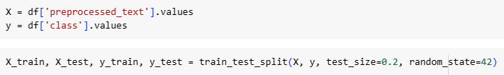
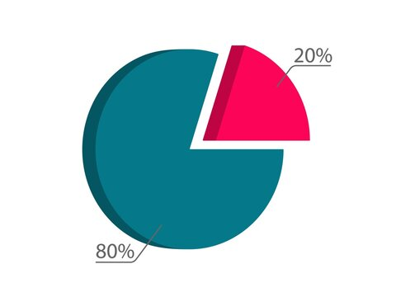
Arabic Sentiment Analyzer (ASA)
Modeling
Splitting Data
Evaluating model
Using Testing set
Training Model
Using Training set
SVM (Support Vector Machine) Algorithm
Testing Set
Modeling
Selecting appropriate algorithm
Model building and Evaluating
Training Set

Slide 30

Modeling
SVM (Support Vector Machine)
Algorithm
- implementation
Efficiency
The SVM algorithm was chosen for its ability to effectively and efficiently classify the Arabic text data into positive and negative sentiment categories.
Evaluating model
Using Testing set
Training Model
Using Training set
Handling Complex Patterns
SVM's capability to identify complex patterns and decision boundaries in high-dimensional feature spaces made it well-suited for the task of Arabic sentiment analysis.
Selecting appropriate algorithm
Splitting Data

Slide 31
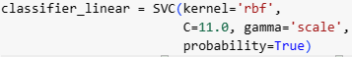
Modeling
- implementation
SVM (Support Vector Machine)
Efficiency
The SVM algorithm was chosen for its ability to effectively and efficiently classify the Arabic text data into positive and negative sentiment categories.
SciKit-Learn
Evaluating model
Library
Using Testing set
The project used SVC (support vector classifier) from SVM module located in sklearn Library
Training Model
Using Training set
Handling Complex Patterns
SVM's capability to identify complex patterns and decision boundaries in high-dimensional feature spaces made it well-suited for the task of Arabic sentiment analysis.
Hyperparameter
Tuning
Selecting appropriate algorithm
The Classifier get fine tuned to give the best fit and prediction accuracy.
Splitting Data

Slide 32
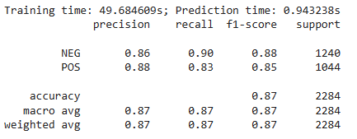
Modeling
Training Model
Trained the model over the Training set with the vectorized preprocessed text as Features and Class label as Target
Evaluating model
SciKit-Learn
Library
The project used SVC (support vector classifier) from SVM module located in sklearn Library
Hyperparameter
Tuning
SVM (Support Vector Machine) - implementation
The Classifier get fine tuned to give the best fit and prediction accuracy.
After extensive training and hyperparameter tuning, the SVM model achieved an impressive accuracy of 86.86% on the Arabic dataset and the detailed calculations as in the table.

Slide 33
Modeling
Training Model
Trained the model over the Training set with the vectorized preprocessed text as Features and Class label as Target
Evaluating model
After extensive training and hyperparameter tuning, the SVM model achieved an impressive accuracy of 86.8% on the Arabic dataset and the detailed calculations as in the table.
Modeling
Model building and Evaluating

Slide 34
Modeling
Arabic Sentiment Analyzer (ASA)
Evaluating model
Using Testing set
Training Model
Using Training set
Model Algorithm
Modeling
Selecting appropriate algorithm
Model building and Evaluating
Splitting Data
Training and Testing sets

Slide 35

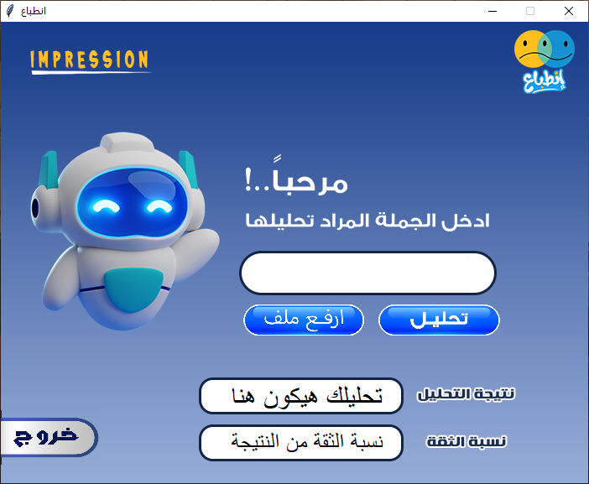
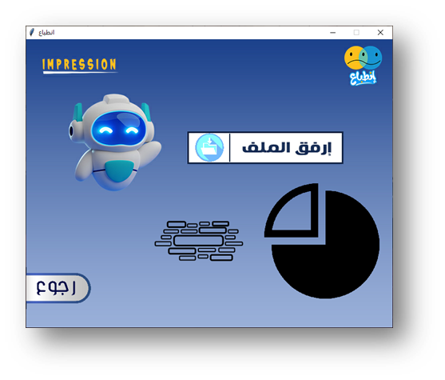
Deployment
Arabic Sentiment Analyzer (ASA)
Project Understanding
Feature Engineering
Identify the Problem and how to solve it
Feature Extraction and Engineering
Gathering Data
Modeling
Project Methodology
Data requirements and Collecting
Model building and Evaluating
Data Preprocessing
Deployment
Data wrangling and Preprocessing
Deploying model and collecting Feedbacks
Tkinter
Library
The project used functions in Tkinter Library to create the Graphical User Interface (GUI)

Slide 36
Arabic Sentiment Analyzer (ASA)
Deployment
Tkinter
Project Understanding
Library
Feature Engineering
Identify the Problem and how to solve it
The project used functions in Tkinter Library to create the Graphical User Interface (GUI)
Feature Extraction and Engineering
Gathering Data
Modeling
Data requirements and Collecting
Model building and Evaluating
Data Preprocessing
Deployment
Data wrangling and Preprocessing
Deploying model and collecting Feedbacks
Project Methodology

Slide 37
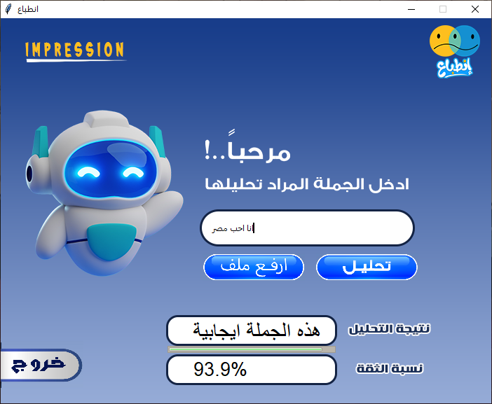

Arabic Sentiment Analyzer (ASA)
Deployment
Tkinter
Library
The project used functions in Tkinter Library to create the Graphical User Interface (GUI)
1st page
2nd page
Example of Positive sentence
Example of negative sentence

Slide 38
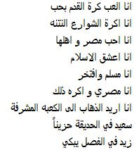
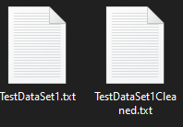
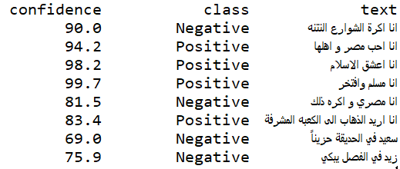
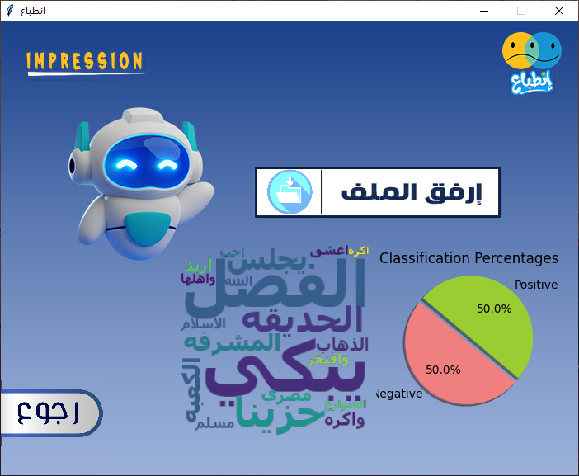
2nd page - Example
2nd page
Deployment
1st page
Example of Positive sentence
Example of negative sentence

Slide 39
1st page
Deployment
2nd page - Example
Example of Positive sentence
Example of negative sentence

Slide 40
Deployment
2nd page - Example

Slide 41
Deployment
2nd page - Example

Slide 42
Deployment
2nd page - Example

Slide 43
Deployment
2nd page - Example

Slide 44
Deployment
2nd page - Example

Slide 45
Project Understanding
Feature Engineering
Identify the Problem and how to solve it
Feature Extraction and Engineering
Arabic Sentiment Analyzer (ASA)
Deployment
2nd page - Example
Project Methodology
Modeling
Gathering Data
Model building and Evaluating
Data requirements and Collecting
Data Preprocessing
Deployment
Data wrangling and Preprocessing
Deploying model and collecting Feedbacks

Slide 46
Deployment
Arabic Sentiment Analyzer (ASA)
Project Understanding
Feature Engineering
2nd page - Example
Identify the Problem and how to solve it
Feature Extraction and Engineering
Gathering Data
Modeling
Project Methodology
Data requirements and Collecting
Model building and Evaluating
Data Preprocessing
Deployment
Data wrangling and Preprocessing
Deploying model and collecting Feedbacks
01
Names similar to Adjectives Handling
Identifying and categorizing proper names.
02
Handling Sentence Negation
Considering the negation words
03
Dataset Size
Avoiding overfitting
04
Appropriate Algorithm Choice
Best performance in complex cases

Slide 47
Arabic Sentiment Analyzer (ASA)
Feature Engineering
Gathering Data
Project Understanding
Modeling
Deployment
Data Preprocessing
Avoided Mistakes
Feature Extraction and Engineering
Identify the Problem and how to solve it
Data requirements and Collecting
Model building and Evaluating
Deploying model and collecting Feedbacks
Data wrangling and Preprocessing
01
Names similar to Adjectives Handling
Identifying and categorizing proper names.
02
Handling Sentence Negation
Considering the negation words
03
Dataset Size
Avoiding overfitting
04
Appropriate Algorithm Choice
Best performance in complex cases

Slide 48
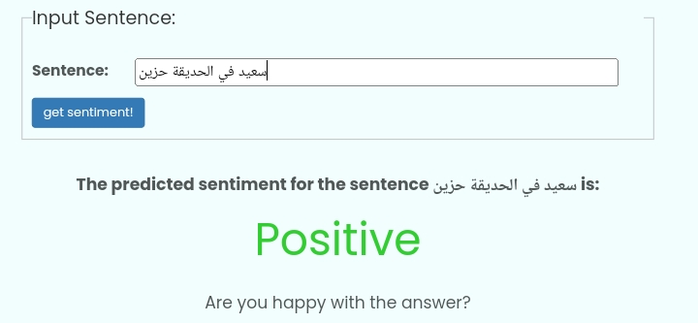

Arabic Sentiment Analyzer (ASA)
Feature Engineering
Gathering Data
Project Understanding
Modeling
Deployment
Data Preprocessing
Avoided Mistakes
Feature Extraction and Engineering
Identify the Problem and how to solve it
Data requirements and Collecting
Model building and Evaluating
Deploying model and collecting Feedbacks
Data wrangling and Preprocessing
01
Names similar to Adjectives Handling
Identifying and categorizing proper names.
Common Mistake
“سعيد في الحديقة حزين”
Inadequate handling of Named Entity
Recognition can result in missed or incorrectly
identified entities, affecting non accurate
results.
Our Solution
Hatmimoha model
We employed advanced NER techniques to
accurately identify and classify entities within
the text, ensuring higher quality information
extraction.
02
Handling Sentence Negation
Considering the negation words
03
Dataset Size
Avoiding overfitting
04
Appropriate Algorithm Choice
Best performance in complex cases

Slide 49
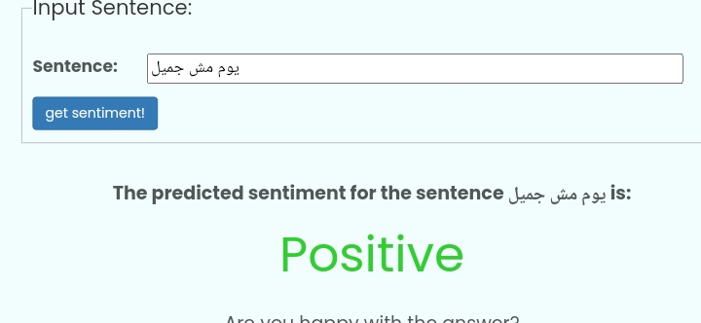

Arabic Sentiment Analyzer (ASA)
Feature Engineering
Gathering Data
Project Understanding
Modeling
Deployment
Data Preprocessing
Avoided Mistakes
Feature Extraction and Engineering
Identify the Problem and how to solve it
Data requirements and Collecting
Model building and Evaluating
Deploying model and collecting Feedbacks
Data wrangling and Preprocessing
02
Handling Sentence Negation
Considering the negation words
Common Mistake
“كان يوم جميل \ مش جميل”
Overlooking the impact of negation in
sentences can lead to incorrect sentiment or
intent classification.
Our Solution
Dataset divertion
Implemented advanced negation handling
techniques to accurately interpret sentence
meanings and in training dataset.
01
Names similar to Adjectives Handling
Identifying and categorizing proper names.
03
Dataset Size
Avoiding overfitting
04
Appropriate Algorithm Choice
Best performance in complex cases

Slide 50
Arabic Sentiment Analyzer (ASA)
Feature Engineering
Gathering Data
Project Understanding
Modeling
Deployment
Data Preprocessing
Avoided Mistakes
Feature Extraction and Engineering
Identify the Problem and how to solve it
Data requirements and Collecting
Model building and Evaluating
Deploying model and collecting Feedbacks
Data wrangling and Preprocessing
03
Dataset Size
Avoiding overfitting
Common Mistake
Small Training DataSet
12.5K
Working with small datasets can limit model
training and lead to overfitting and poor
generalization to new data and reduce overall
accuracy.
51 %
Negative Labels
Our Solution
6.62K Observations
Expand DataSet
49 %
Positive Labels
We expanded our dataset significantly, which
improved the model's accuracy and
generalizability. leading to better training and
more robust performance.
6.32K Observations
01
Names similar to Adjectives Handling
Identifying and categorizing proper names.
02
Handling Sentence Negation
Considering the negation words
04
Appropriate Algorithm Choice
Best performance in complex cases

Slide 51
Arabic Sentiment Analyzer (ASA)
Feature Engineering
Gathering Data
Project Understanding
Modeling
Deployment
Data Preprocessing
Avoided Mistakes
Feature Extraction and Engineering
Identify the Problem and how to solve it
Data requirements and Collecting
Model building and Evaluating
Deploying model and collecting Feedbacks
Data wrangling and Preprocessing
04
Appropriate Algorithm Choice
Best performance in complex cases
Common Mistake
Select the wrong algorithm
86.8 %
SVM
Accuracy
Using Naive Bayes due to its simplicity, which
might not always provide high accuracy.
83.9 %
Naïve Bayes
Accuracy
Our Solution
Expand DataSet
We used Support Vector Machine (SVM) due to
its superior accuracy in our context, leading to
better performance. extensive hyperparameter
tuning to achieve the best possible results.
01
Names similar to Adjectives Handling
Identifying and categorizing proper names.
02
Handling Sentence Negation
Considering the negation words
03
Dataset Size
Avoiding overfitting

Slide 52
Arabic Sentiment Analyzer (ASA)
Feature Engineering
Gathering Data
Project Understanding
Modeling
Deployment
Data Preprocessing
Avoided Mistakes
Feature Extraction and Engineering
Identify the Problem and how to solve it
Data requirements and Collecting
Model building and Evaluating
Deploying model and collecting Feedbacks
Data wrangling and Preprocessing
01
Names similar to Adjectives Handling
Identifying and categorizing proper names.
Input
POS Handling
NER Handling
02
Handling Sentence Negation
Normalizing
Considering the negation words
Stemming
Stop Words removing
PreProcessing Stage
Dataset Size
03
Avoiding overfitting
Feature Extracting
04
Appropriate Algorithm Choice
Model Predicting
Best performance in complex cases
Result

Slide 53



Arabic Sentiment Analyzer (ASA)
Feature Engineering
Gathering Data
Project Understanding
Modeling
Deployment
Data Preprocessing
Project Overview
Feature Extraction and Engineering
Identify the Problem and how to solve it
Data requirements and Collecting
Model building and Evaluating
Deploying model and collecting Feedbacks
Data wrangling and Preprocessing
Mahmoud Ahmed Shimy
Team Leader –
GUI & Model Developer
Ahmed Gamal Abdallah
Graphic Designs –
Preprocessing Developer
Input
POS Handling
NER Handling
Normalizing
Stemming
Stop Words removing
PreProcessing Stage
Feature Extracting
Model Predicting
Result
Michael Naeem Khalaf
Feature Engineering –
Preprocessing Developer
01
Names similar to Adjectives Handling
Identifying and categorizing proper names.
02
Handling Sentence Negation
Considering the negation words
03
Dataset Size
Avoiding overfitting
04
Appropriate Algorithm Choice
Best performance in complex cases

Slide 54
Project Team
Mahmoud Ahmed Shimy
Team Leader –
GUI & Model Developer
Ahmed Gamal Abdallah
Graphic Designs –
Preprocessing Developer
Michael Naeem Khalaf
Feature Engineering –
Preprocessing Developer
We would especially want to thank our supervisor, Dr. Azza Taha, for her extraordinary support on this project and for all of her help, resources, and advice. Her commitment and knowledge were quite helpful in assisting us in reaching our objectives. We sincerely appreciate her guidance during this process.

Slide 55
Thanks!
Mahmoud Ahmed Shimy
Team Leader –
GUI & Model Developer
We would especially want to thank our supervisor, Dr. Azza Taha, for her extraordinary support on this project and for all of her help, resources, and advice. Her commitment and knowledge were quite helpful in assisting us in reaching our objectives. We sincerely appreciate her guidance during this process.
Ahmed Gamal Abdallah
Graphic Designs –
Preprocessing Developer
Michael Naeem Khalaf
Feature Engineering –
Preprocessing Developer

